Slide 1
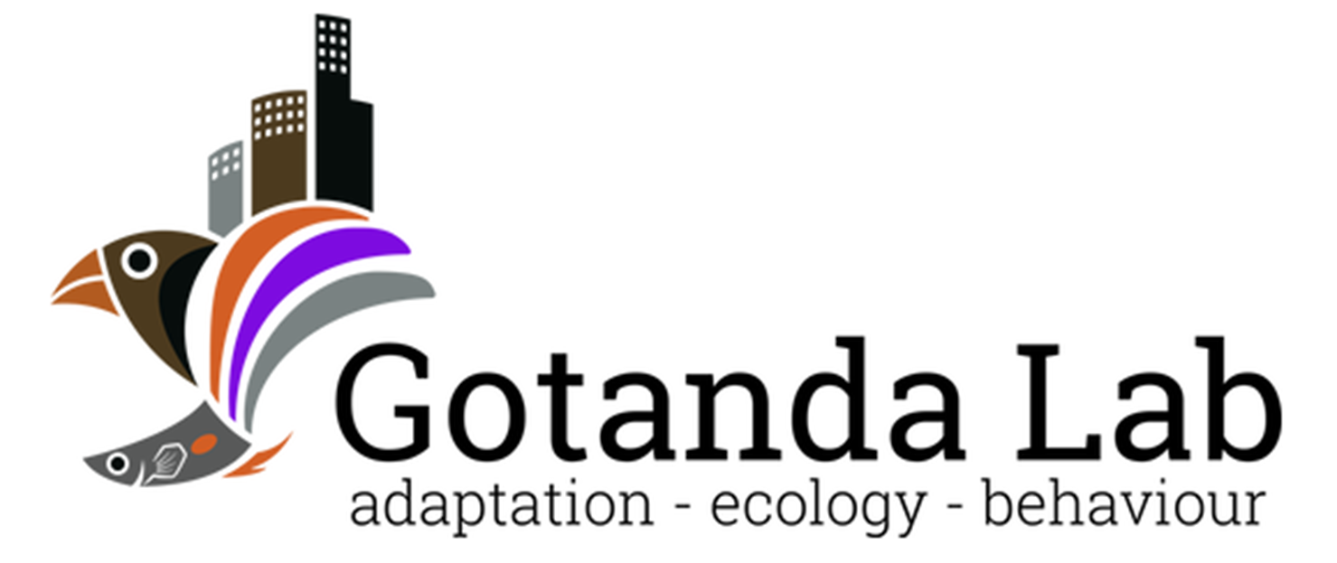

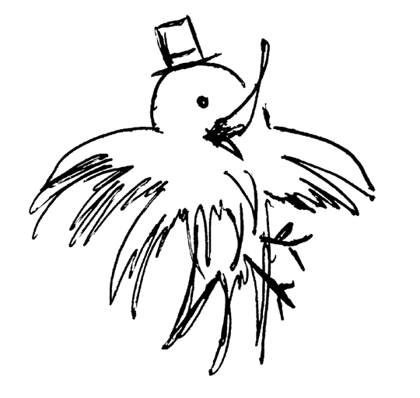
Heads Up!
Social Vigilance Behavior in American Crows
Alex Popescu, Dr. Anne B. Clark, Dr. Kiyoko M. Gotanda
GRaD 2023
Brock University

Slide 2
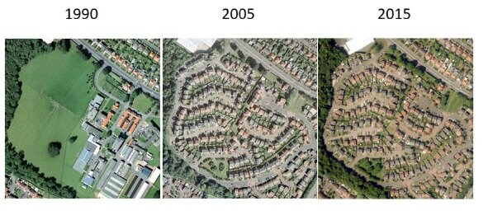
Urbanization
The shift in human population from rural to urban areas
An example of urbanisation in Edinburgh 1990 to 2015 Credit: CEH
Notes:
~55% of world population currently concentrated in urban areas, with the UN projecting that number to climb to 68% by 2050.

Slide 3
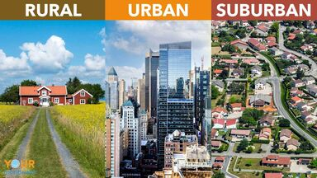
Urbanization
Leads to changes in the environment:
↓ Lines of sight
↑ Human-animal interactions
↓ Green spaces
Has negative effects on many species; associated with the global loss of biodiversity
https://examples.yourdictionary.com/identifying-difference-between-rural-urban-suburban
Kowarik I. 2011 Novel urban ecosystems, biodiversity, and conservation. Environ. Pollut. 159

Slide 4
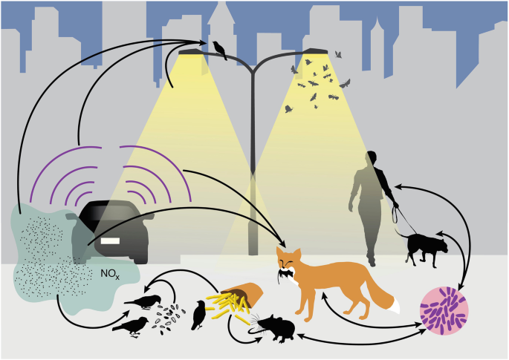
Can species be successful in cities?
Yes!*
* Will depend on species’ traits
Advantageous traits:
Adaptability
A generalist nature
An omnivorous diet
Intelligence
Isaksson, C. (2018). Impact of Urbanization on Birds. In: Tietze, D. (eds) Bird Species
Patankar S et al. 2021 Which Traits Influence Bird Survival in the City? A Review. Land 10
Notes:
Modified diet
↑ Interspecific aggression
↑ Tolerance of risks
↑ Tolerance of human proximity

Slide 5
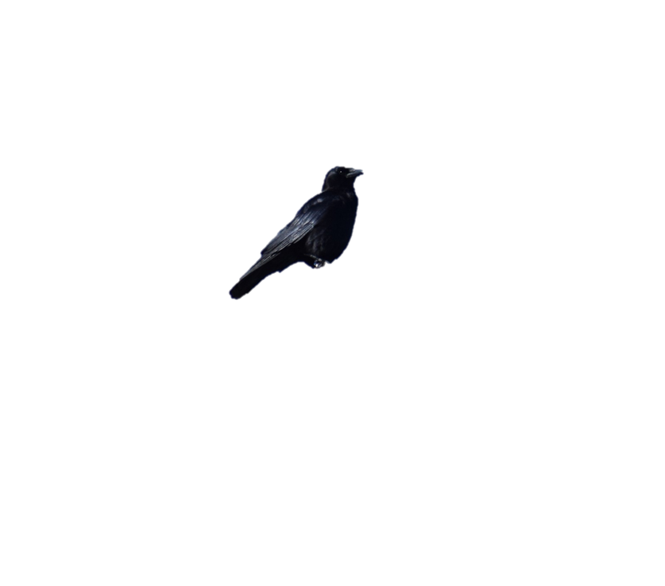
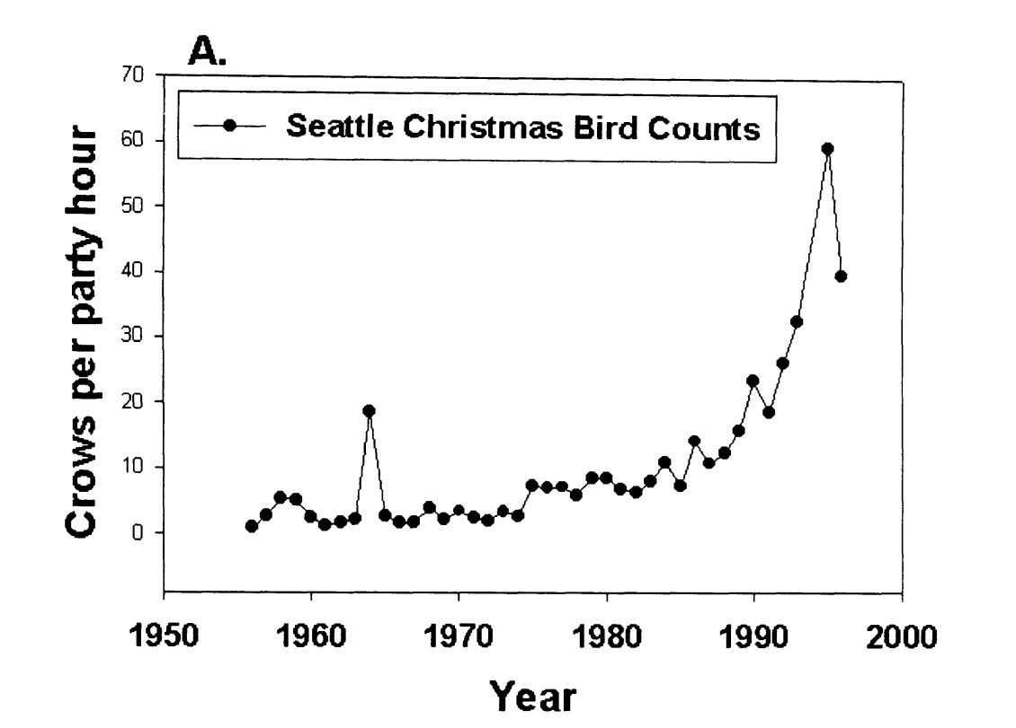
American crows in urban areas
Does the social nature of urbanized species contribute to their success in urban areas?
Crows spotted per hour
American crows (Corvus brachyrhynchos) are an ideal model to test for social behaviors in urbanized species.
Marzluff et al.(2001). Avian Ecology and Conservation in an Urbanizing World || Causes and consequences of expanding American Crow populations.
Notes:
We picked the crow bc… Talk about G. env

Slide 6
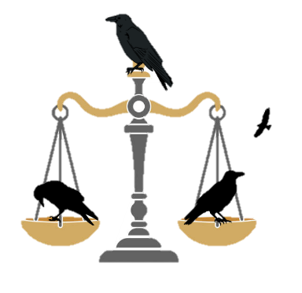
Vigilance and social foraging behavior
A trade-off between vigilance and foraging efficiency
Too much is like not enough
Notes:
Prediction:
Hold your audience’s hand for the predictions. Be explicit!

Slide 7
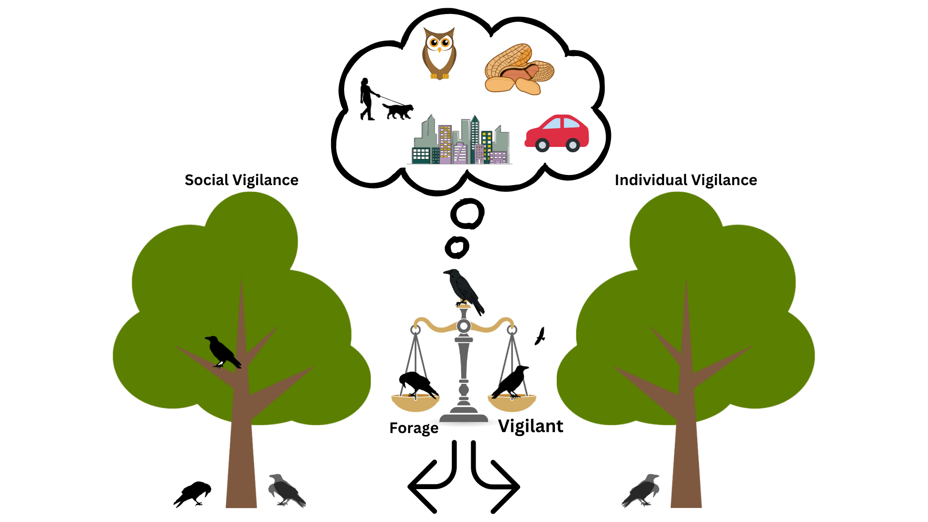
Sentinels
The sentinel ensures the protection of foraging group-members through constant vigilance.
Costly behavior to the sentinel, but very beneficial to foragers.
Social Foraging
Individual Foraging
Notes:
Shorten! Remove too much info about sentinels & focus on urbanization/G. Env

Slide 8
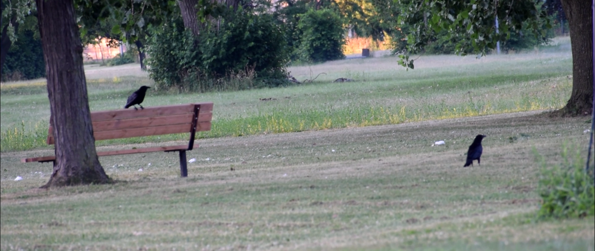
Sentinels
The presence of a sentinel is expected to reduce the vigilance of foragers.
Notes:
Remove prediction about sentinels, just show what sentinels look like.

Slide 9
My objective
Determine if an individual’s foraging vigilance affected by the presence of a sentinel and the environment in which it forages in.
The modified use of sentinel behaviors is understudied.
Could explain, in part, the success of American crows in urban areas.
Notes:
Update this and add B-WW-SB. Be explicit!

Slide 10
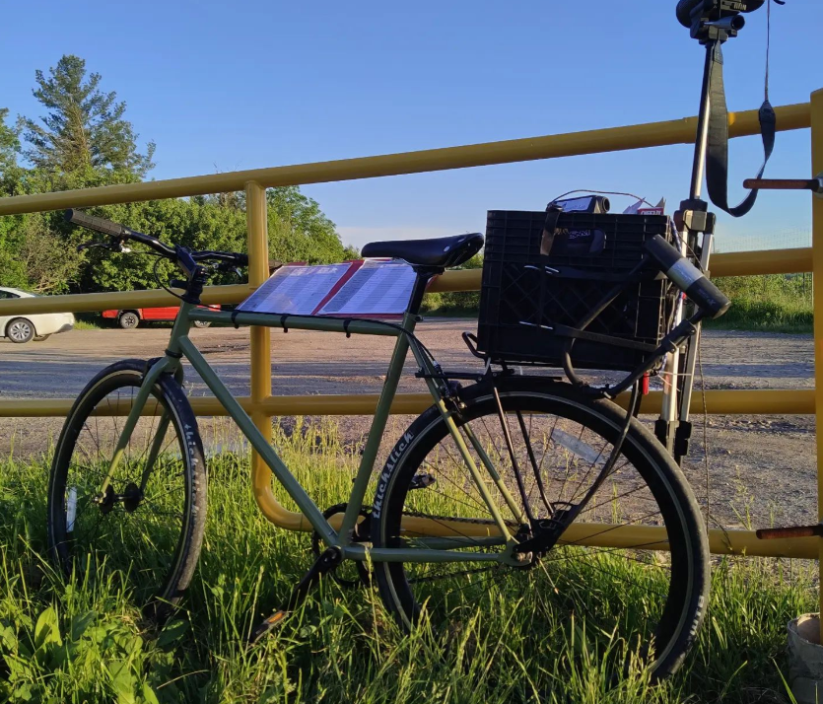
Methods
Testing sites were selected through a community science initiative: Crowkémon Go
Notes:
Explain verbally WHY you baited the sites.

Slide 11
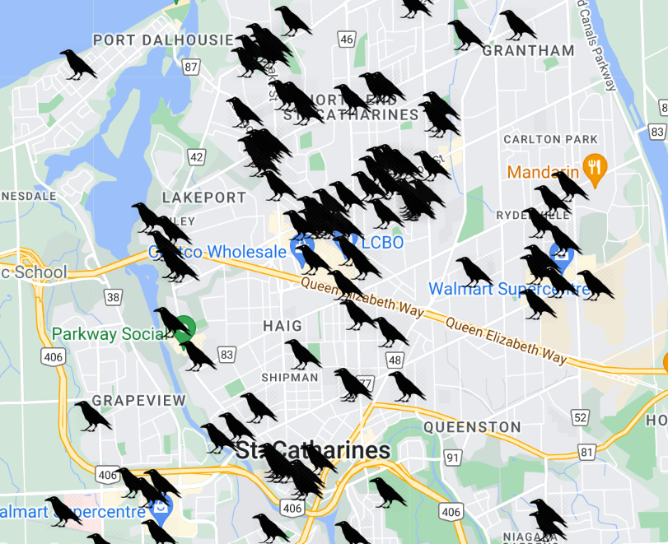
Crowkemon Go
Started in Jan 2022
Participants across the Niagara region were invited to mark the locations of crows.
Notes:
Be concise!

Slide 12
Methods
Testing sites were selected through a community science initiative: Crowkémon Go
Sites were visited and baited regularly in the morning
Foraging bouts were video recorded from a distance and coded at a later date
Notes:
Armed with friends, cameras and bicycles, we bravely went out at 6am to chase crows!
Remove bait

Slide 13
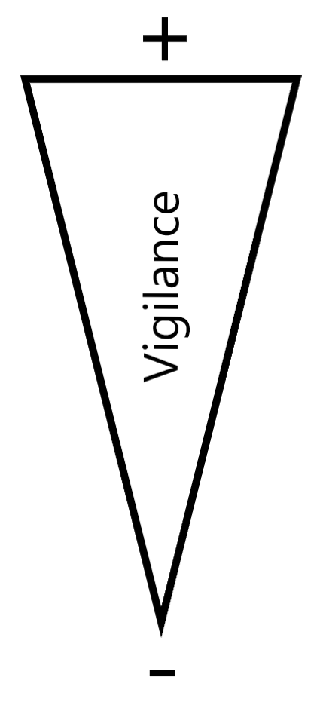



Methods
Alert
Moving
Foraging
Notes:
Can’t tell what the crow is looking at when moving (verbal)

Slide 14
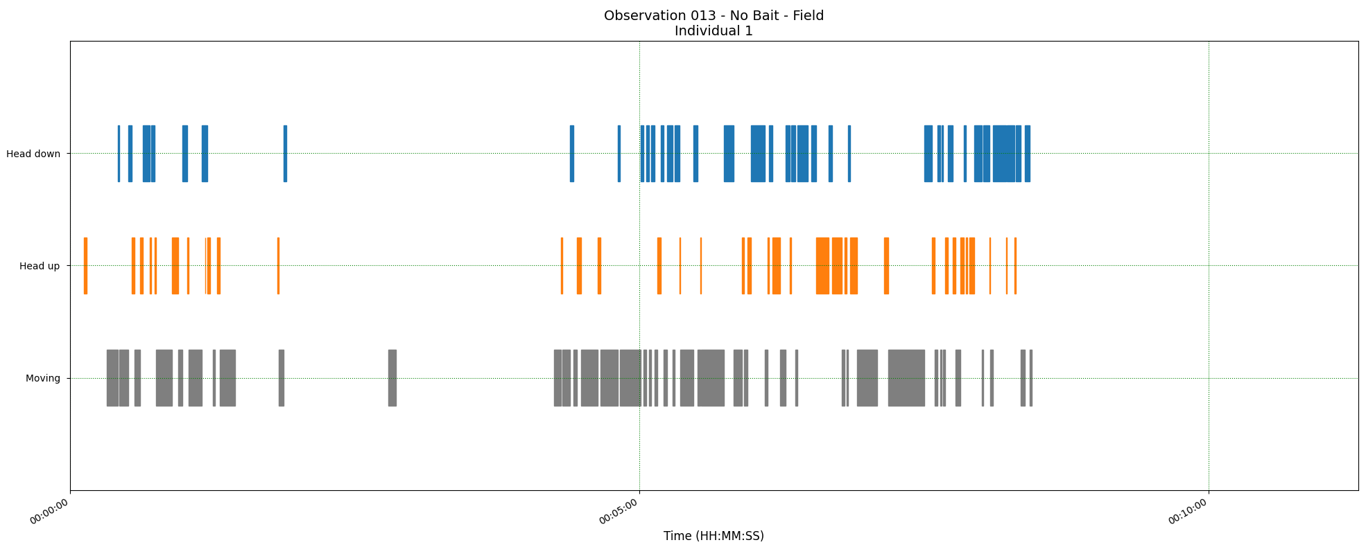
Methods
Three measurements:
The proportion of ‘foraging time’ allocated to each behavior
Duration of behavioral instances
Peck rate
Foraging
Alert
Moving
Time
Notes:
***Briefly explain & put arrows to show what each measurement is ***
**DO NOT MENTION BORIS!!!**

Slide 15
Research questions
 | Green Areas | Commercial Areas | Sentinel Present | Sentinel Absent
Allocation of time to behaviors in foragers | Foraging ↑ Alert ↓ | Foraging ↓ Alert ↑ | Foraging ↑ Alert ↓ | Foraging ↓ Alert ↑
Duration of behavioral instances | Foraging ↑ Alert ↓ | Foraging ↓ Alert ↑ | Foraging ↑ Alert ↓ | Foraging ↓ Alert ↑
Foraging efficiency of foragers | Peck rate ↓ | Peck rate ↑ | Peck rate ↑ | Peck rate ↓
Likelihood of a sentinel being present | ↑ | ↓ | X | X
Notes:
Remove right side of table, focus only on G.Env.

Slide 16
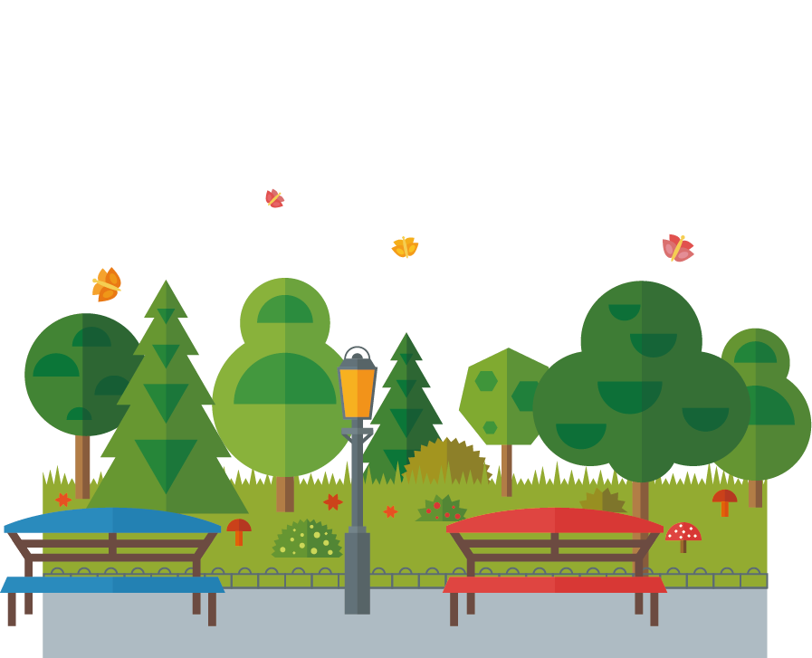

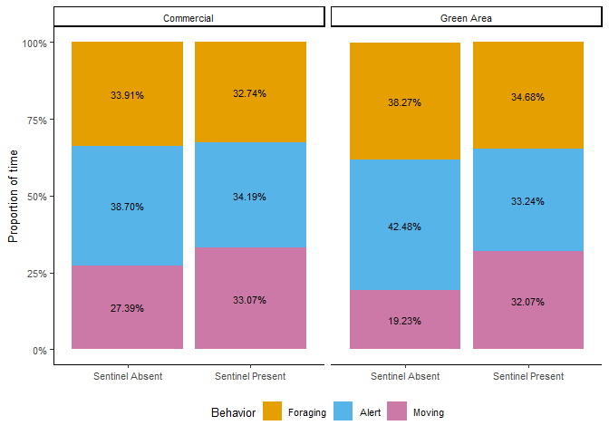

Proportion of time
Contrary to my predictions, there were no significant effects!
Proportion of foraging time
If not the proportion, could it be the duration of instances that change?
Notes:
Compare only across environment, remove sentinel presence/absence

Slide 17
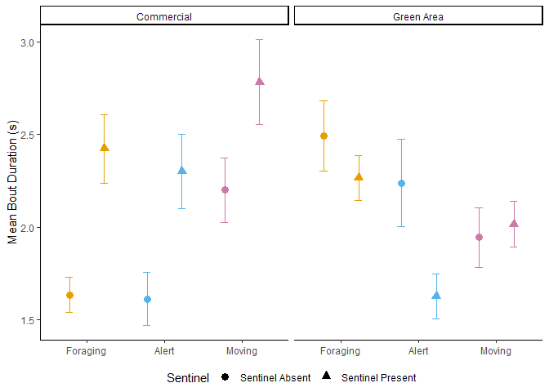

Instance duration
Head Down > Head Up
Sentinel present > Sentinel Absent
Green Areas > Commercial Areas
Mean Behavioral Instance Duration (s)
But this is across ALL behaviors
Absent
Present
Notes:
Remove sentinel presence/absence, only talk about G. Env

Slide 18
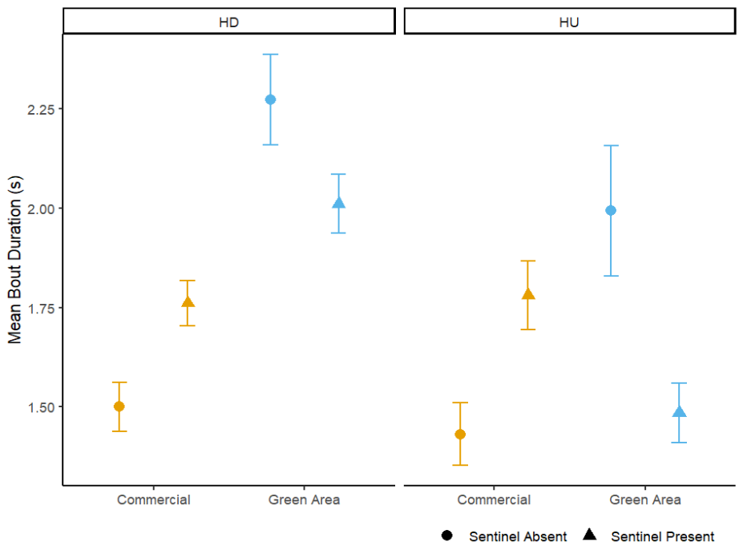
Separate behaviors – Head Up & Head Down
Head Down
Head Up
Head Down:
- No effect of sentinel behavior (p=0.201)
- Increased duration in green areas (p=<0.001)
- Decreased duration in the presence of BAIT
Head Up:
- No effect of sentinel behavior (p=0.141)
- No effect of generalized environment (p=0.198)
Notes:
Condense with previous slide, remove sentinel presence!
Remove bait

Slide 19
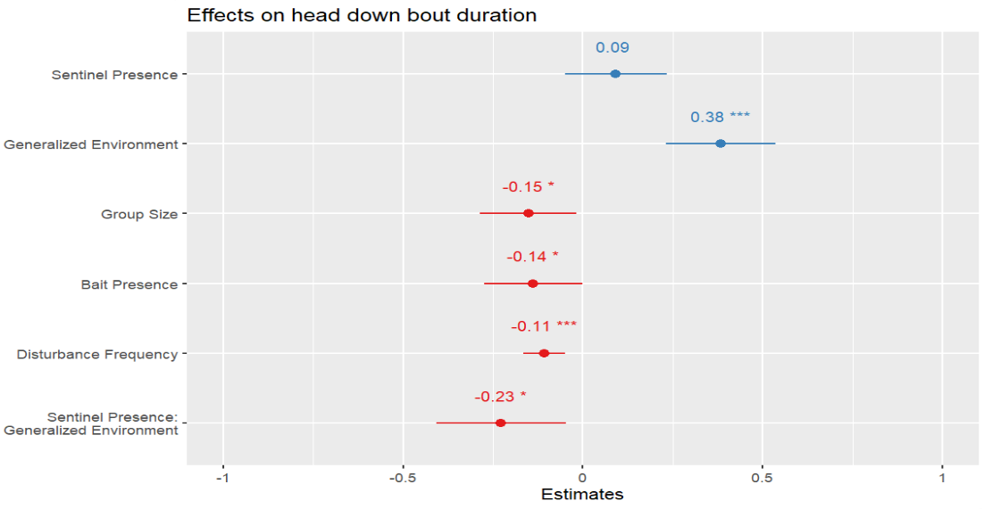
Head Down
Definitely some interesting results!
Foraging bout ↑ in Green areas = ↑ handling + searching time
Foraging bout ↓ as disturbance freq. ↑ and
group size ↑
Urgency!
Notes:
Keep, but shorten ramblings.
Remove urgency. Too deep.
Remove bait, Don’t have time to talk about it. Can ignore.

Slide 20
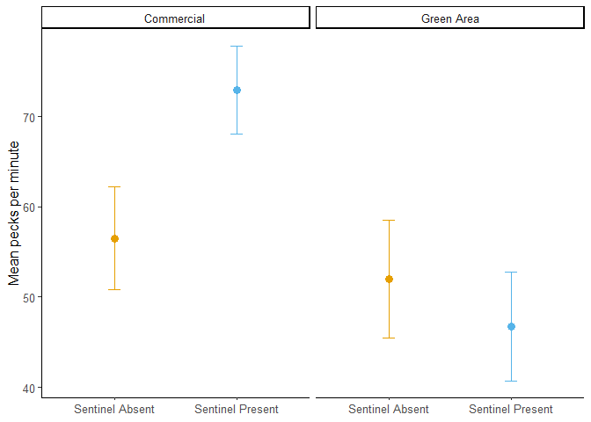
Peck rate
The environment and the presence of bait had a significant effect, but not the presence of a sentinel.
Peck rate higher in commercial areas.
Mean Pecks per Minute
Notes:
Remove sentinel presence, keep only G.Env & make comparisons across.
Remove bait

Slide 21
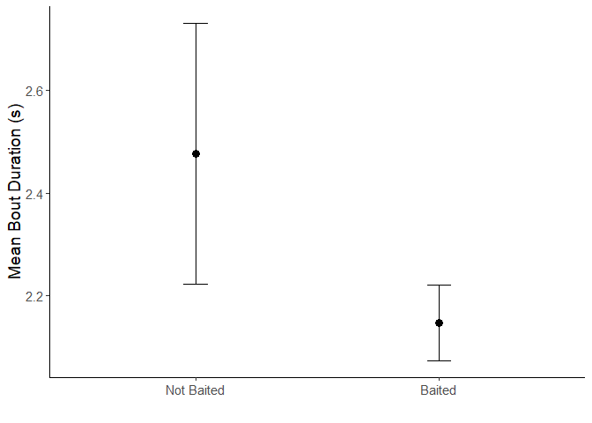
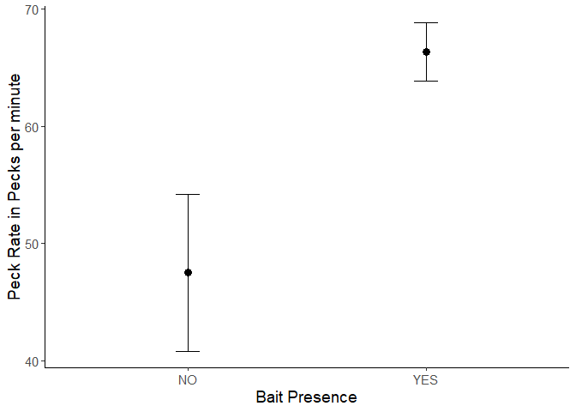
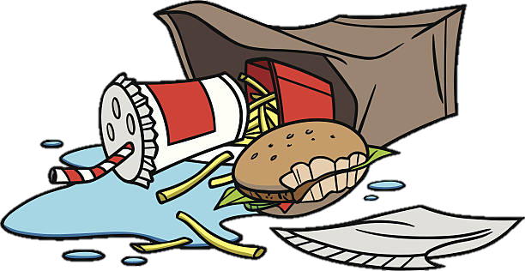
Bait
Mean Foraging Instance Duration (s)
Baited sites had significantly shorter foraging instances yet faster peck rates.
Concentrated, food-dense patches
Less time looking for and handling food, but greater foraging efficiency.
Mean Pecks per Minute
Notes:
Remove entirely

Slide 22
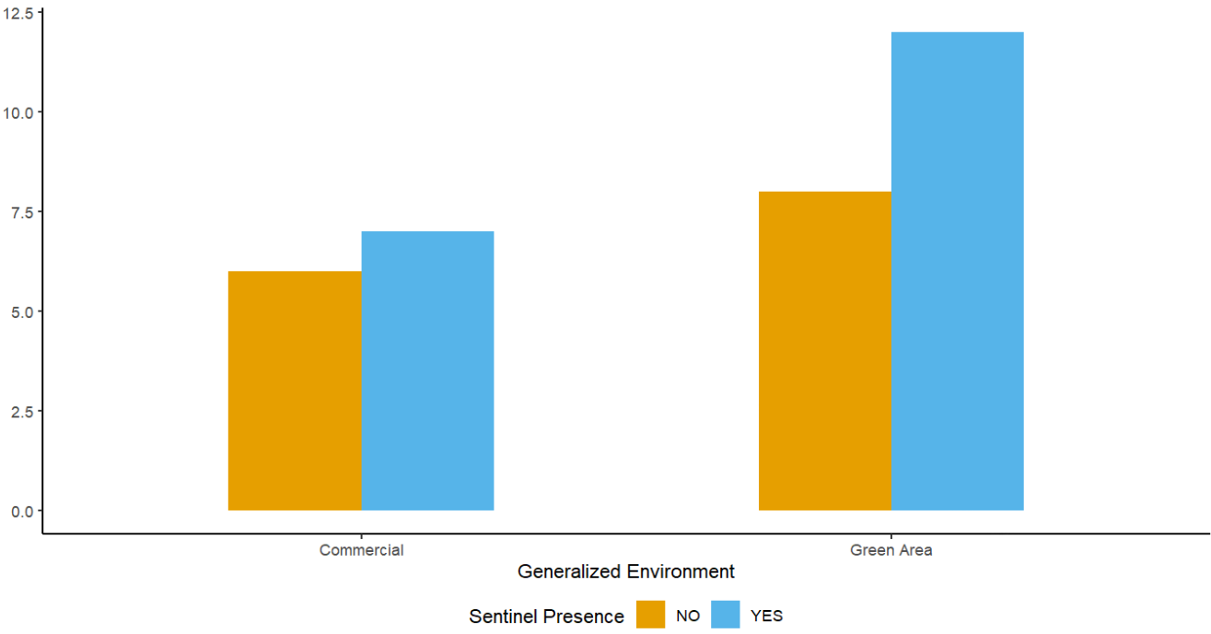
Likelihood of sentinel presence
No effect of generalized environment!
What about group size and disturbance frequency?
Commercial
Green Area
Notes:
Make text larger, give y-axis label (NOT ‘count’)
Consider removing if prez too long.

Slide 23
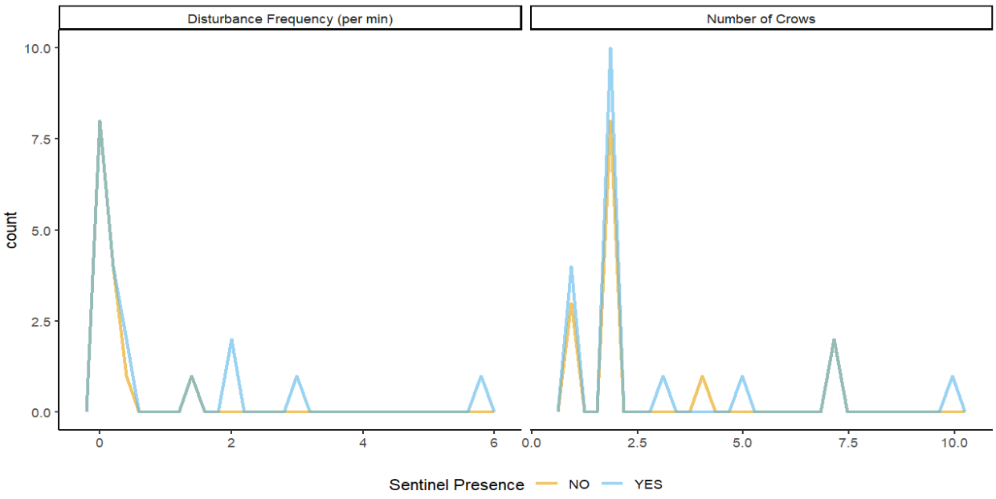
Likelihood of sentinel presence
Better to leave than be sentinel
‘Dilution Effect’
No significant effects!
Notes:
Remove if prez too long.
Seems like overconcluding, remove extra commentary.

Slide 24
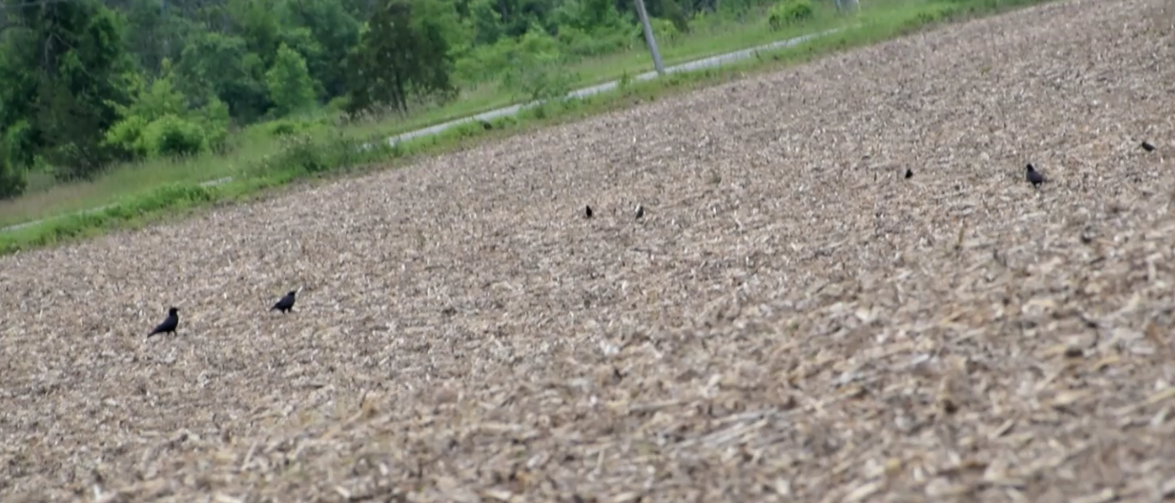
Some caveats
It is impossible to tell what the crows are looking at when being alert:
Looking for threats and predators
Other species
Other crows
Did they find something?
Notes:
Add image to take up some of the white space before putting the big image up.

Slide 25

Research questions
 | Green Areas | Commercial Areas | Sentinel Present | Sentinel Absent
Allocation of time to behaviors in foragers | Foraging ↑ Alert ↓ | Foraging ↓ Alert ↑ | Foraging ↑ Alert ↓ | Foraging ↓ Alert ↑
Duration of behavioral instances | Foraging ↑ Alert ↓ | Foraging ↓ Alert ↑ | Foraging ↑ Alert ↓ | Foraging ↓ Alert ↑
Foraging efficiency of foragers | Peck rate ↓ | Peck rate ↑ | Peck rate ↓ | Peck rate ↑
Likelihood of a sentinel being present | ↑ | ↓ | X | X
No effect
No effect
No effect
Foraging ↑
Foraging ↓
No effect
No effect
Notes:
Remove right side, focus only on G. Env.
Be quick about it, no need to repeat, consider having the table reappear between results slides.

Slide 26

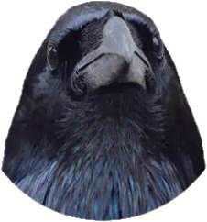
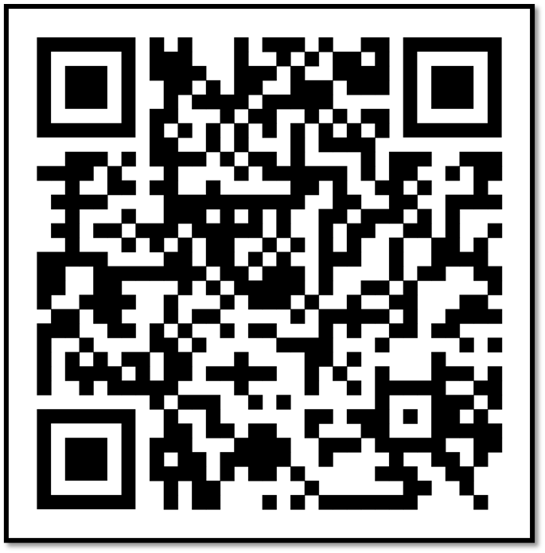

Crowkémon Go
Notes:
Put this as the end of slide. Or remove entirely if presentation too long.

Slide 27
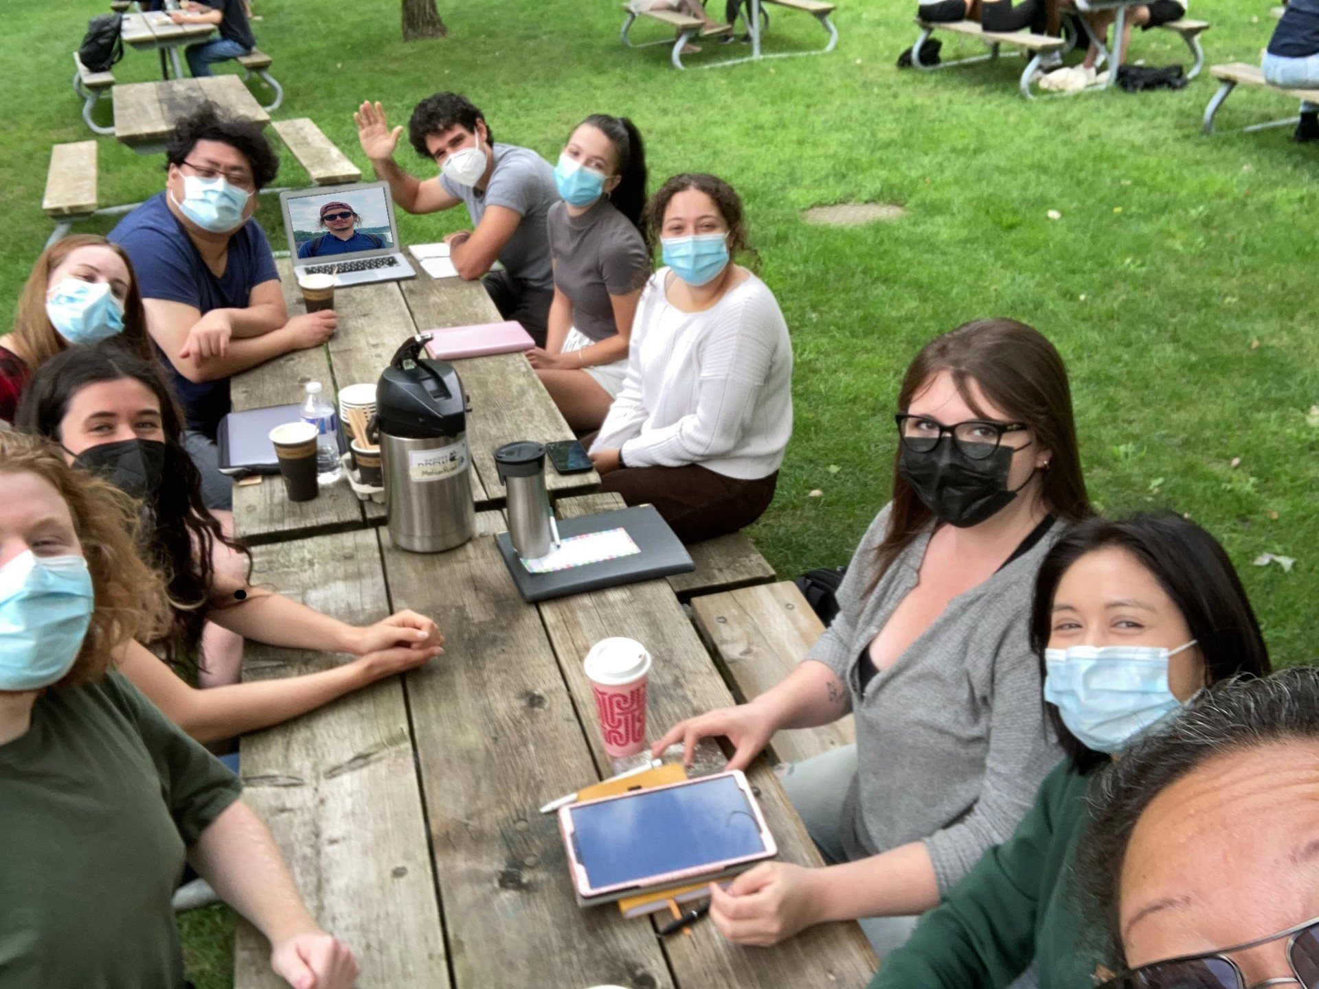

Acknowledgements
My supervisors: Dr. Kiyoko Gotanda, Dr. Liette Vasseur, Dr. Anne Clark
The Gotanda Lab
My family and friends
Notes:
Funded by Brock, no need to mention explicitly. Thank funding sources at a defense (which this isn’t)

Slide 28
Questions?
Scan this to learn more about Crowkémon Go

Slide 29
General feedback
Only compare environments, remove sentinel presence entirely
Re-do graphs in R to reflect ^^^
MAKE SHORTER!!! – Cut back even more on theory to talk more about the results.
Less details, more punchlines -> Tie into B-WW-SB *Define*
Explain the results briefly, talk about them afterwards (if anyone has questions)
Stop repeating yourself, unless necessary
Update website if you’re going to have the QR code (might not have time)

